Slide 1
2018 REVIEW & 2019 TARGET
NGUYEN XUAN HUNG (818873)
DIV1 GROUP (MO + MS)

Slide 2
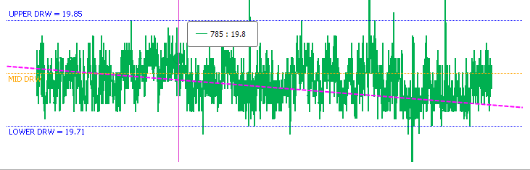
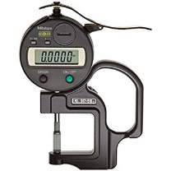
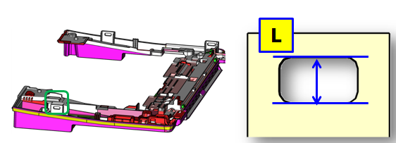

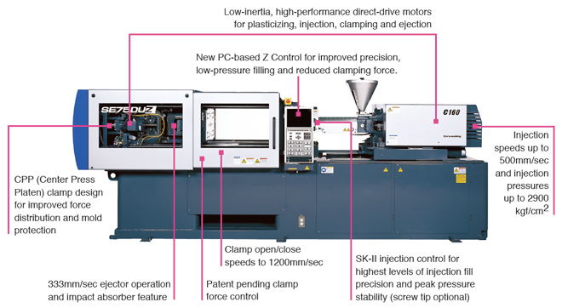
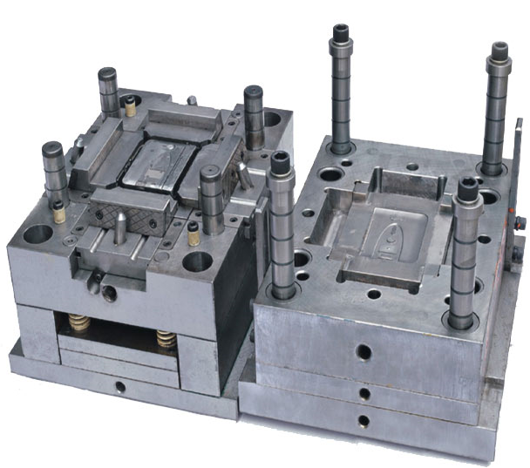
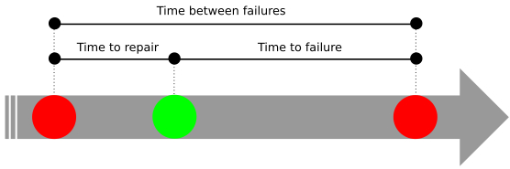
ABOUT MY MAIN JOB
=> IMPROVE TS-MOLD’S JOB
1. Quality product assurance
1. TS-MSD
Expand
2. TL-MSD
3. QV-MSD
4. TL-MO
MTTR
MTBF
2. Machine & Die
MTTF

Slide 3
2018 REVIEW
I
Expand “Quality control system”
II
Build “LOG container round use system”
III
Improve “Equipment control system”

Slide 4
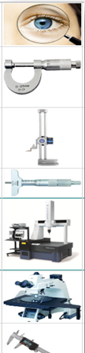
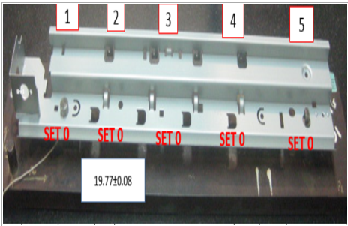
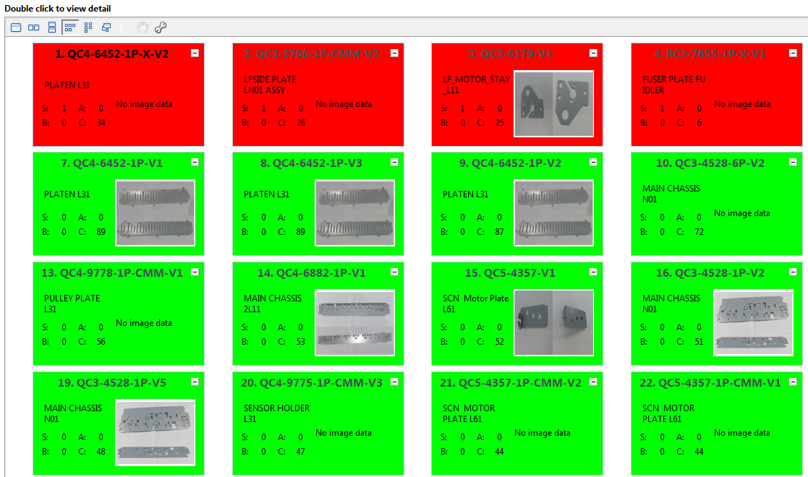

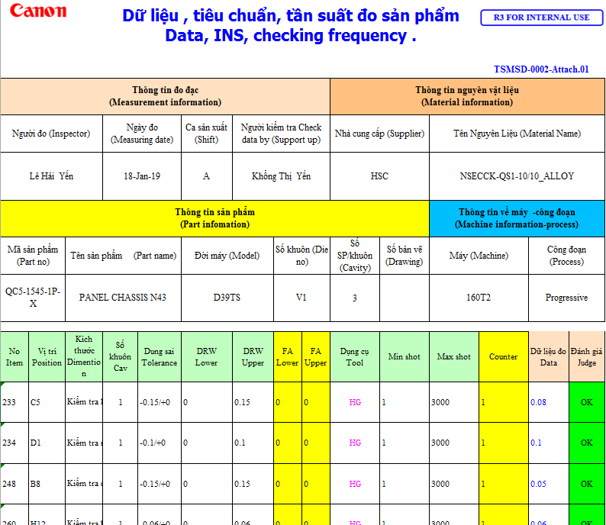
I. Expand Quality System (From TS-MO to TL-MO,TL-MQA, TS-MSD, TL-MSD, QV-MSD)
Visual check by picture
Ranking part by part
Share trouble
Tendency of data
Auto issue ISO data sheet
Visual check by picture and guideline -> Reduce mistake
Control tendency of measuring data -> Quick action before trouble happen
Build method for measurement tool -> Clear measuring position (reduce mistake).
Automatic judge worst/good part product by ranking -> Visualize situation all of part
Automatic issue ISO datasheet, checksheet -> Reduce 100% paper sheet

Slide 5
II. Build LOG container round use system(CRU)
* How to select the best container round to reduce cost ???
Old flowchart
Email of TL
Record container round use
Analyze for report
Vendor 1,2,3…n
1
2
4
Record container round use
5
Forwarder 1,2…n
Email of TS
Analyze for report
3
TL, TS, QV LOG
Email of QV
Record container round use
Analyze for report
* Many duplicate job between 3 factories (manual confirm, record, make report)
* Easy to mistake info from vendor, FWD and 3 factories
TS/TL/QV import schedule
New flowchart
Vendor 1,2,3…n
1
3
2
Email server
CRU system
5
Analyze for report
Forwarder 1,2…n
4
* Automatic receive & read mail -> calculate & select container-> record->
send mail confirm -> make report
PIT

Slide 6
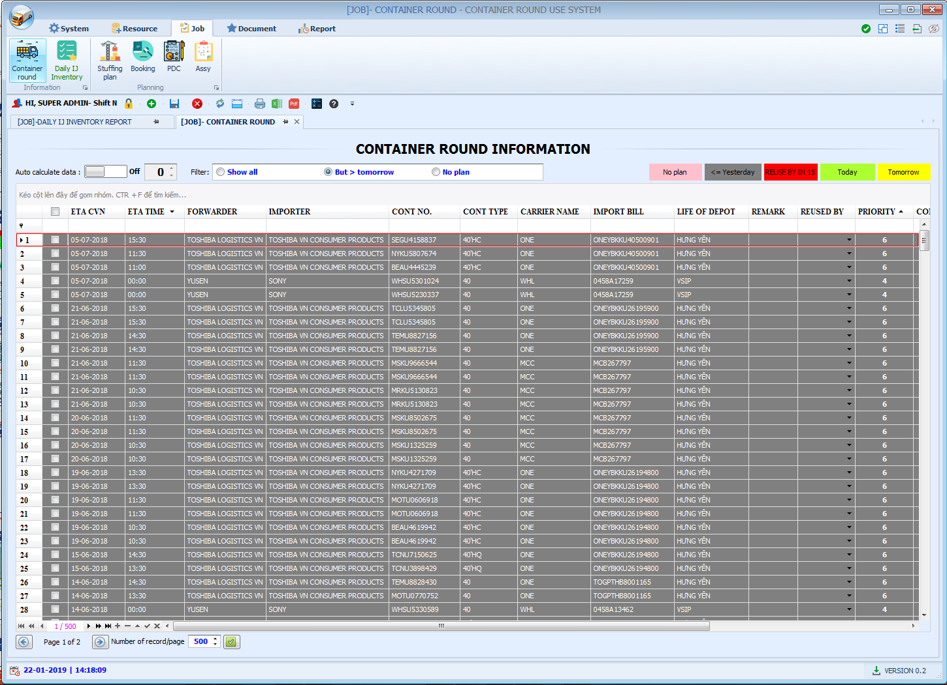
II. Build LOG container round use system(CRU)
Read mail from server
Auto set priority for round
PIT

Slide 7
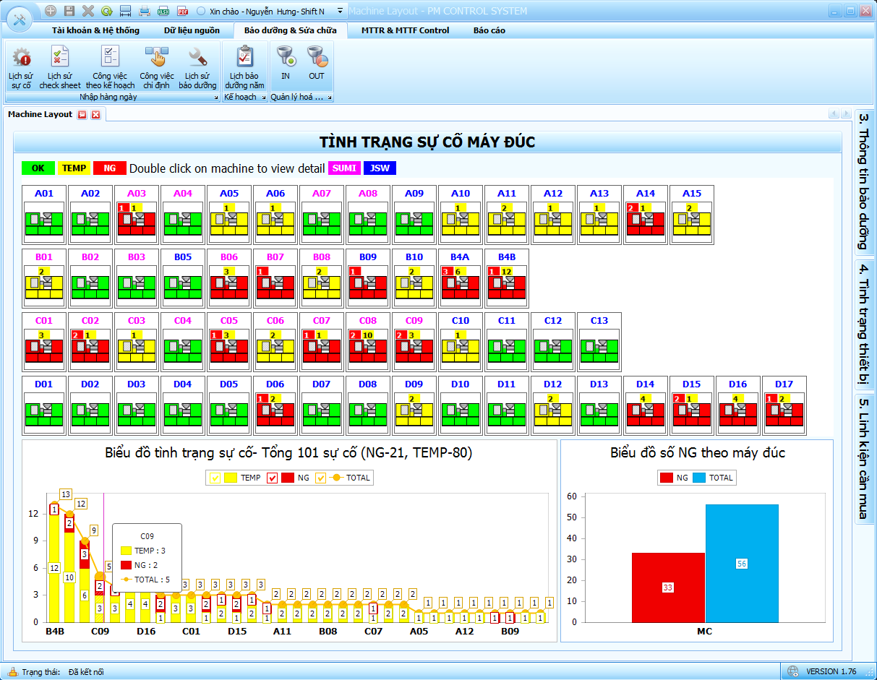
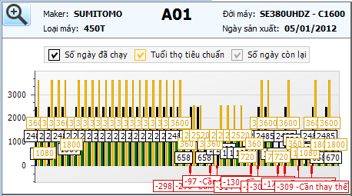
III. Improve equipment control system
Visualize life time situation all of
part machine
(life time remain to order new)
Visualize trouble situation all of machine
Order by number of trouble remain
PIT

Slide 8
2019 TARGET
From TS-MO to TS-MSD, TL-MSD, QV-MSD
Expand Die Control System
Study & train for PIT members
RPA Training
For ACC, LOG, PUR, CMG..
RPA Make & Apply

Slide 9
RPA SCHEDULE
No | Action items | 2019
 |  | Jan | Feb | Mar | Apr | May | Jun | Jul | Aug
1 | RPA Training
2 | Make RPA program for trial version (3 jobs)
3 | Evaluation
4 | Make RPA program (4 jobs / 1 month)
5 | Selection of vendor
6 | Check Contract
7 | Canon INC Decision
8 | Order Software & Hardware
9 | Delivery time/Preparation
10 | Go live Actual environment.

Slide 10
Thank You !

